Slide 1
My Perimeter, Area and Volume Interactive Notebook
Name
Class
Term 3 Semester 2

Slide 2
Contents
Formula Page
Page
Date
Description
2
3

Slide 3
Tasks
24
7
30
Essential Question
Questions
Notes
Summary
20
21

Slide 4
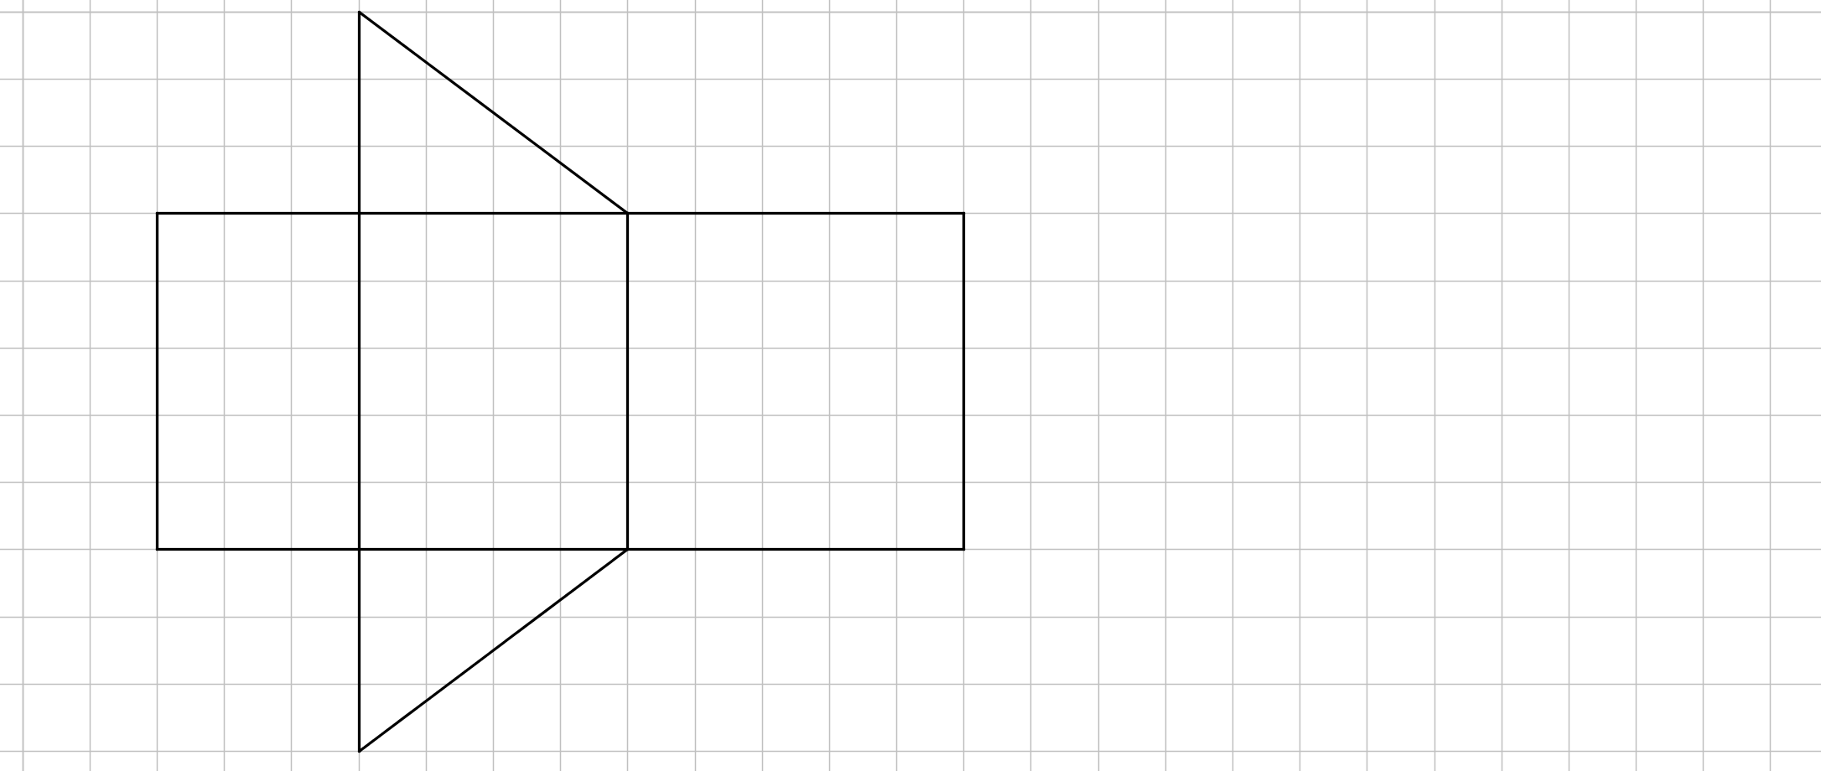
24
7
30
Date
Triangular Prisms
EQ – How is a net of a 3-D shape used to find the surface area of a triangular prism?
A prism is a 3-D shape that has the same shape through out its length
A net is a 2-D picture that folds to make a 3-D shape.
21

Slide 5
Task
1. Fill in the following-
A triangular prism has
___ faces,
___ edges and
___ vertices.
2. Find the area of each face.
3. Find the total surface area for the triangular prism
4. Find the volume for the triangular prism

Slide 6
Task
1. Fill in the following-
A triangular prism has
5 faces,
9 edges and
6 vertices.
2. Find the area of each face.
3. Find the total surface area for the triangular prism
4. Find the volume for the triangular prism

Slide 7
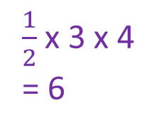
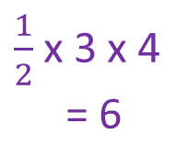
Task
1. Fill in the following-
A triangular prism has
5 faces,
9 edges and
6 vertices.
2. Find the area of each face.
3. Find the total surface area for the triangular prism
4. Find the volume for the triangular prism
3 x 5 = 15
$\frac{1}{2}$ x 3 x 4
= 6
$\frac{1}{2}$ x 3 x 4
= 6
4 x 5 = 20
5 x 5 = 25

Slide 8
Task
1. Fill in the following-
A triangular prism has
5 faces,
9 edges and
6 vertices.
2. Find the area of each face.
3. Find the total surface area for the triangular prism
2 x 6 +
4. Find the volume for the triangular prism
3 x 5 = 15
$\frac{1}{2}$ x 3 x 4
= 6
$\frac{1}{2}$ x 3 x 4
= 6
4 x 5 = 20
5 x 5 = 25

Slide 9
Task
1. Fill in the following-
A triangular prism has
5 faces,
9 edges and
6 vertices.
2. Find the area of each face.
3. Find the total surface area for the triangular prism
2 x 6 + 15 +
4. Find the volume for the triangular prism
3 x 5 = 15
$\frac{1}{2}$ x 3 x 4
= 6
$\frac{1}{2}$ x 3 x 4
= 6
4 x 5 = 20
5 x 5 = 25

Slide 10
Task
1. Fill in the following-
A triangular prism has
5 faces,
9 edges and
6 vertices.
2. Find the area of each face.
3. Find the total surface area for the triangular prism
2 x 6 + 15 + 20 +
4. Find the volume for the triangular prism
3 x 5 = 15
$\frac{1}{2}$ x 3 x 4
= 6
$\frac{1}{2}$ x 3 x 4
= 6
4 x 5 = 20
5 x 5 = 25

Slide 11
Task
1. Fill in the following-
A triangular prism has
5 faces,
9 edges and
6 vertices.
2. Find the area of each face.
3. Find the total surface area for the triangular prism
2 x 6 + 15 + 20 + 25 = 72cm²
4. Find the volume for the triangular prism
3 x 5 = 15
$\frac{1}{2}$ x 3 x 4
= 6
$\frac{1}{2}$ x 3 x 4
= 6
4 x 5 = 20
5 x 5 = 25

Slide 12
Task
1. Fill in the following-
A triangular prism has
5 faces,
9 edges and
6 vertices.
2. Find the area of each face.
3. Find the total surface area for the triangular prism
2 x 6 + 15 + 20 + 25 = 72cm²
4. Find the volume for the triangular prism 6 x 5 = 30cm³
3 x 5 = 15
$\frac{1}{2}$ x 3 x 4
= 6
$\frac{1}{2}$ x 3 x 4
= 6
4 x 5 = 20
5 x 5 = 25

Slide 13
24
7
30
Date
Triangular Prisms
EQ – How is a net of a 3-D shape used to find the surface area of a triangular prism?
TSA = Sum the area of all the faces
Volume = Area of triangle x Length
21

Slide 14
Questions

Slide 15
24
7
30
Date
Triangular Prisms
EQ – How is a net of a 3-D shape used to find the surface area of a triangular prism?
How do I find the Surface area and volume of a triangular prism?
TSA = Sum the area of all the faces
Volume = Area of triangle x Length
21

Slide 16
Notes Review
24, 7 ,30
Date
Title
Essential question
Notes complete
Notes complete with colour and diagrams
Questions completed
Contents page filed in
Formula page filled in

Slide 17
Homework
Review your notes and write a summary answering the essential question.

Slide 18
Plenary
Draw three shapes with a perimeter of 36cm.

